Slide 1
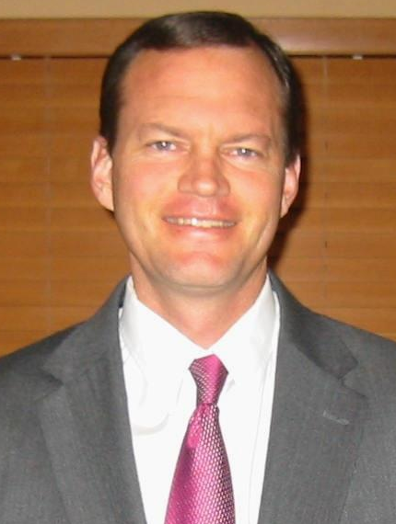
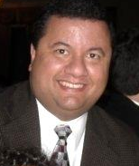
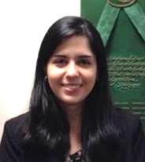
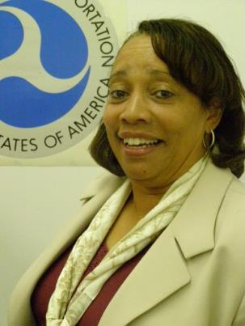

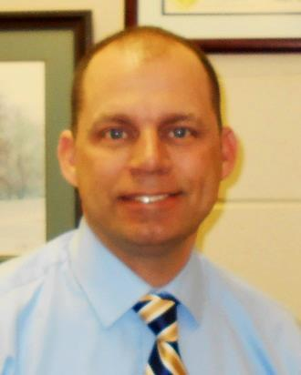
PROJECT DELIVERY TEAM
Design, ITS and ADHS
Professional Development Program
Team Leader, Pavement and Materials
Construction, Maintenance and Asset Management
Safety, Emergency Relief and Traffic Operations
Transportation Engineer
Notes:
My name is Darrin Grenfell – etc.
Some of you may have met me when I came to the Districts to present the Stewardship Agreement.
The SA is an agreement between FHWA and KYTC which delegates to KTYC many roles, responsibility and authority to carry out much of the Federal Aid Program.
The KY office has traditionally overseen the interstate program, the Appalachian program, and major projects over $ 100 million dollars as “Full Oversight.:
This next year, FHWA and KYTC will change some of the oversight to focus on Projects of Division Interest. We will be calling the PODI projects and I will explain more at the end of this presentation.
Right now I would like to introduce the Project Delivery Team:
This year we welcome two new members to our team:
Lisell Guerra who is on the EIT program and is currently doing an assignment with KYTC Central Office
John Callihan is a former KYTC employee who was a branch manager for District 5, before working for the ACOE and now FHWA;
The PDT members are assigned Districts and Program Areas:
With the addition of John Callihan to the team, these assignments will be changing and the Districts will receive an email showing the changes, soon.
The KY office now has a Bridge Engineer again – Bode Borres, former KTYC employee has been our bridge Engineer now for a few months;

Slide 2
FHWA – Every Day Counts
Every Day Counts 2: FHWA/KYTC Initiatives
3-D Modeling: 1 Project – D09 (KY 7);
Ongoing Evaluation;
Transportation Incident Management (TIM):
523 responders trained
in 6 Agency Types;
High Friction Surface courses:
95 sites;
84% Crash Reduction over three years
Accelerated Bridge Construction (ABC):
Guidance Developed by Bridge Division
Increased implementation of ABC for low volume bridges
Notes:
Read Slide
Under EDC 2: There will be $ 100 K available to the STATE TRANSPORTATION INNOVATION COUNCIL, for use in implementation of technologies;

Slide 3
MAP 21-Changes to the Federal Program
ER Program:
FHWA April 2, 2013 letter to KYTC
Categorical Exclusion expanded use
Must include FHWA Form 1273 in contracts
Debris removal To Be completed by FEMA funds with a Presidential Declaration
Buy America Application to Utilities;
All Utilities on a Federal Aid Project
Utilities reimbursed with Federal Aid
Utilities Not reimbursed with Federal Aid
Thank you for all you do!
Notes:
Read from Slide;

Slide 4
MAP 21 and Performance Measures
> Final Rule effective February 27, 2013
- Amended 23 CFR 635.411 Material or Product Selection . . . autonomy to State DOTs regarding the selection of culvert and storm sewer material types
MAP-21 Requirement: Risk and performance based measurements on the NHS: Examples,
Interstate must meet an established IRI target value
NHS bridges must meet established target values
Notes:
- KYTC can select culvert type and will be Federal Aid eligible: However, KYTC must meet design standards – including long term performance and maintenance per 23 CFR part 625 and as required by patented and proprietary products under 23 CFR 635.411;
Pavement and Bridge Management maintenance standards have been set in past years by KYTC and meeting the requirements of the term “adequate maintenance.” as monitored by DOTs and FHWA, however, MAP-21 will require performance measures to be developed and met or exceeded.
Penalty - reduced Federal share for NHPP projects in that year
States determine the Performance Areas: Pavements, Bridge, Safety, etc., FHWA will develop Performance Targets through consultation with All States:

Slide 5
Construction and Work Zones
Other For Kentucky (Construction)
Supplemental Specifications
Change Order Process
Work Zones
Notes:
Supplemental Specifications: A monthly review and coordination between FHWA and KYTC has resulted in revisions to approximately 135 specs since the publishing of the June 2012 edition;
Change Order Process: 1) Discuss with FHWA 2) Send draft by email and request verbal approval; 3) Send final copy for final approval;
Work Zones: Since 2009 we have continued to see a decline in work zone fatalities for Kentucky. From 2008 – 2012 a total of 33 out of 3,842 fatalities in motor vehicle traffic crashes less than 1 percent. Give yourselves a hand for your part in keeping our work zones safe

Slide 6
Highway Safety Improvement Program
HSIP MAP-21 Investment Plan
Outlines project types and expenditures
Notice of Proposed Rulemaking Coming Soon
Potential changes to program
I-69 Corridor Interstate Designation and Improvements
Notes:
Ryan Tenges is Area Engineer for Districts and is also our Division Office Safety Engineer:
The investment plan was approved in May of 2013. It specifies the improvement types and programs that KY focuses on in its HSIP. It also specifies the amount of funding set aside for each program.
The NPRM will propose and define fatalities and serious injuries measures along with target establishment, progress assessment, and reporting requirements for the HSIP.
Ryan also manages the I-69 Agreements and corridor improvements in Districts 1 and 2 so that the Penrile and Western KY Parkways can be designated as interstate 69..

Slide 7
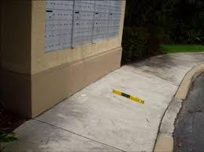
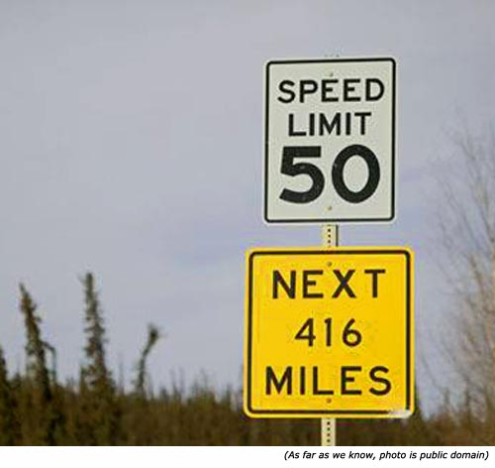
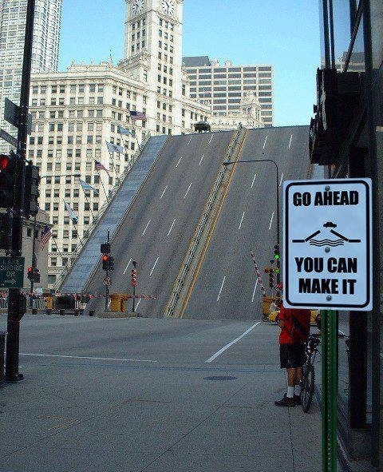
Highway Design, ITS and ADHS
Design
ADA Training to KYTC
Peer-2-Peer with INDOT
Design for Pedestrian Accessibility
2 sessions in 2014
Interstate Access (Statewide)
Approx. 10 proposals in last 18-months
Corridor Geometric Design (DES/GLS)
I-69 + I-65 widening through D04
Standard Drawings
3DM (EDC2)
ITS
New rule on travel time (Traffic Ops)
ADHS
Annual Status Update submitted to ARC
Notes:
Michael Loyselle is our Division Design Engineer:
FHWA Kentucky and Indiana Divisions hosted a peer-to-peer exchange with KYTC and INDOT on ADA/Section 504 (sidewalk/curb ramp construction and maintenance) during the Fall 2013.
DFPA Training – hands-on sessions on design/construction of sidewalks and curb ramps. Two sessions were held in 2012 (Louisville and Frankfort); two more are being proposed during CY14 to cover eastern and western part of the State;
10 proposals have been coordinated, reviewed, and/or approved in the last 18-months under Michael’s leadership; These requests include new interchanges like the I-75 interchange near the Toyota Plant north of Lexington and reconstruction of other interstate interchanges;
Also, he assists in ensuring design standards for the I-69 and I-65 corridors are being in place:
Finally, he is involved in continuing improving KY Standard Drawings and implementing the 3D Modeling initiative in KY, as part of the EDC2 Program.
On ITS, Michael is co-leading efforts with our planning staff and KYTC-Traffic Operations to ensure Kentucky complies with the new rule on Section 1201 of SAFETEA-LU (carried onto MAP-21) regarding Real Time Systems Management Information Program (RTSMIP);
Finally, he also manages the ADHS program;

Slide 8
Oversight – CAP/PODI Being Developed
Compliance Assessment Program (CAP)
52 Projects Randomly Selected
Core Project Questions and Areas of Review:
DBE
Work Zone Traffic Control
Environmental Commitments
Projects of Division Interest (PODI):
Currently being identified
Interstate/APD/Federal Actions and Program Areas
Notes:
FHWA HQ has asked Division Offices to implement the CAP program and develop a PODI project list;
CAP process:
Last year – 52 projects and four review forms;
This year – TBD
Each PODI will have a Oversight Plan that will be shared with the KYTC, like the Partnership Agreement and it will identify the information FHWA will be requesting form KYTC .
PODI are being identified and are likely to include:
Program Areas like Environment/Design/Construction/Safety/Bridge;
Federal Actions (IMR, Design Exceptions, Construction Procurement)
Interstate Corridors (I-65 widening; I-69 Designation)
APD
Major Projects (Over $ 100 million)

